Slide 1
Java Programming. #00 About course
Dmitry Chub
Telegram: @dmchub

Slide 2
Course plan
Intro in Java, syntax
Collections
OOP
Date and time, regular expression
App testing
Project building. Maven
Stream API
Concurrency
Work with DB in Java, JDBC

Slide 3
Homeworks
5 homeworks
2-step homework review
Auto tests at Yandex.Contest (HW 1,2) or validation of your tests (HW 3,4,5)
Code review at GitLab
Deadlines (1-2 weeks for each homework):
Soft: -50% of points
Hard: -100% of points

Slide 4
Required software
JDK: OpenJDK (preferable) or Oracle
IDE: Intellij IDEA (preferable), Eclipse or NetBeans, (vim)
Database Management System: Postgres (preferable), MySQL, SQLServer or H2
Git: GitLab

Slide 5
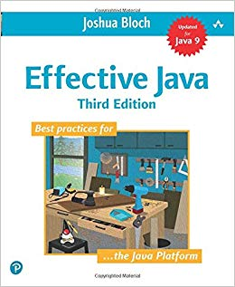
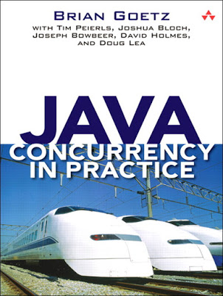
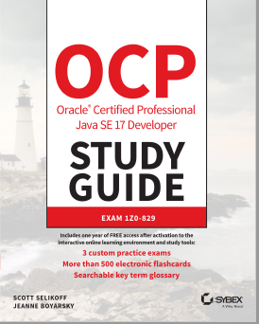
Recommended books
J. Bloch “Effective Java”
Br. Goetz “Java concurrency in practice”
J. Boyarsky ”OCP Oracle Certified Professional”

